Slide 1
Dart: Types & Operations (Chapter 3), Strings (Chapter 4), Control Flow (Chapter 5)

Slide 2
Dart: Types & Operations

Slide 3
Data Types in Dart
In Dart, a type is a way to tell the compiler how you plan to use some data. You’ve already seen the following types:
Int
double
Num
dynamic
String
Types like int, double and num are subclasses, or subtypes, of the Object type (everything in dart is an object).

Slide 4
Annotating Variables Explicitly
Type annotation when declaring a variable means writing the data type before the variable name.
To make variables immutable (unchangeable), you can keep the type annotation, and add const or final in front.
Creating Constant Variables

Slide 5
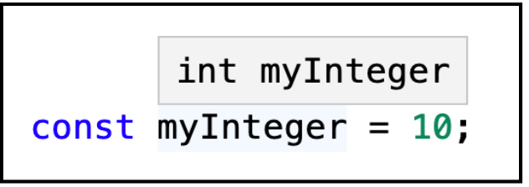
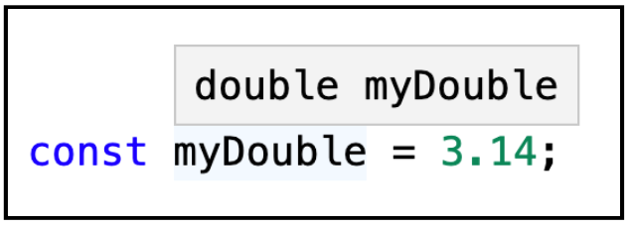
Type inference
Type inference is a process that enable the compiler to deduce the type of the variable. This mean that you don’t need to explicitly write the type every time
Not all programming languages have type inference, but Dart does.
In the following code, Dart infers that myInteger is an int and myDouble is a double.
Checking the Inferred Type in VS Code
You can do this in VS Code by hovering your mouse pointer over the variable name. VS Code will display a popover like this:

Slide 6
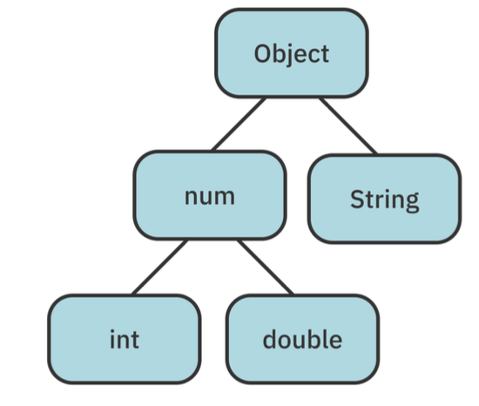
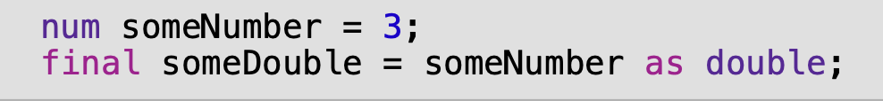
Casting Down
The image below shows a tree of the types you’ve encountered so far. \you may have a variable of some general supertype, but you need functionality that is only available in a subtype. If you’re sure that the value of the variable actually is the subtype you need, then you can use the as keyword to change the type.
This is known as type casting. When type casting from a supertype to a subtype,
it’s called downcasting.
Example:
The runtime type of someNumber is int, not double. In Dart, you’re not allowed to cast to a sibling type, such as int to double. You can only cast down to a subtype.
If you do need to convert an int to a double at runtime, use the toDouble method that you saw earlier:

Slide 7
Dart: String

Slide 8
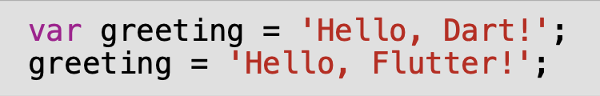

Strings and Characters in Dart
ّIn the example bellow, due to type inference, Dart knows that greeting is of type String. Since you used the var keyword, you’re allowed to reassign the value of greeting as long as the new value is still a string.
Greeting will be assigned with a new value. This means completely discard the string 'Hello, Dart!' and replace it with a whole new string whose value was 'Hello, Flutter!’.
Dart doesn’t have Character or char type.
In the example bellow, letter is only one character long, it’s still of type String
Getting Characters

Slide 9



Single Quotes vs. Double Quotes
ّDart allows you to use either single quotes or double quotes for string literals. Both of these are fine:
We will use double quotes because Flutter style guide does recommend using single quotes. In addition if your string includes any apostrophes double quotes will be better to avoid confusing.
Otherwise, you would need to use the backslash \ as an escape character so that Dart knows that the string isn’t ending early:

Slide 10
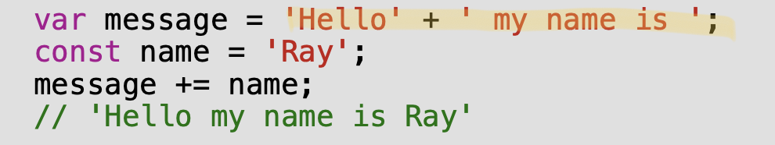
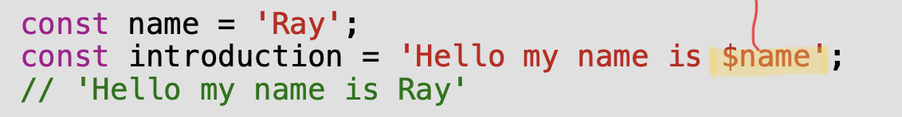
Concatenation
Concatenation is combining a string with another string.
In Dart, you can concatenate strings simply by using the addition operator. Just as you can add numbers, you can add strings:
Interpolation
Interpolation is a special Dart syntax that lets you build a string in a manner that’s easy for other people reading your code to understand.

Slide 11
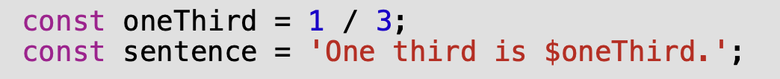

Interpolation
You can build a string from other data types such as numbers. Lets consider the following example , in which double is used for the interpolation:
Your sentence constant will contain the following value:
You can control the number of decimal places shown on a double by using toStringAsFixed along with the number of decimal places to show:
The sentence variable needs to be final now instead of const because toStringAsFixed(3) is calculated at runtime.

Slide 12
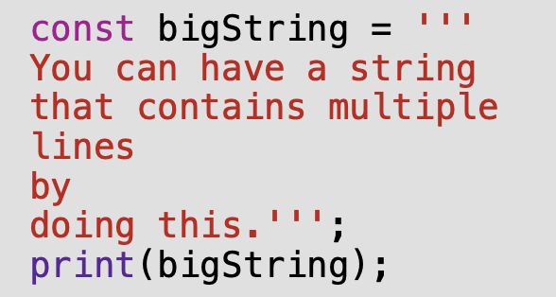
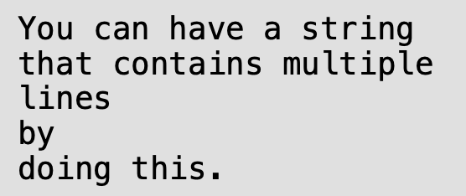
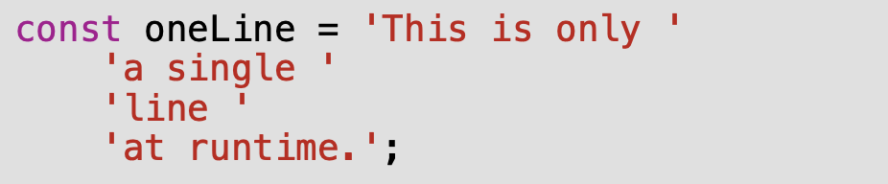
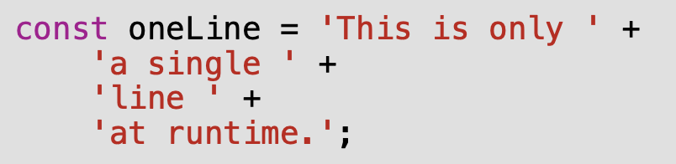
Multi-Line Strings
The three single quotes (''') signify that this is a multi-line string. Three double quotes (""") would have done the same thing.
Notice that all of the newline locations are preserved. If you just want to use multiple lines in code but don’t want the output string to contain newline characters, then you can surround each line with single quotes or you concatenated each of those lines with the + operator:

Slide 13
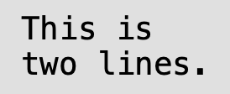




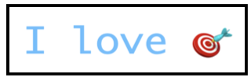
Multi-Line Strings
If you want to insert a newline character, you can use \n.
If you want to ignore any special characters that a string might contain. To do that, you can create a raw string by putting r in front of the string literal.
Inserting Characters From Their Codes
You can also add Unicode characters if you know their codes using \u,

Slide 14
Dart: Control Flow

Slide 15
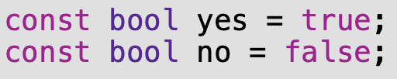
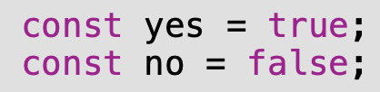
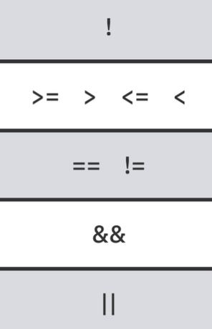




Boolean Values
In Dart boolean type is called bool
Boolean Operators
String Equality
In Dart, you can compare strings using the standard equality operator, ==

Slide 16
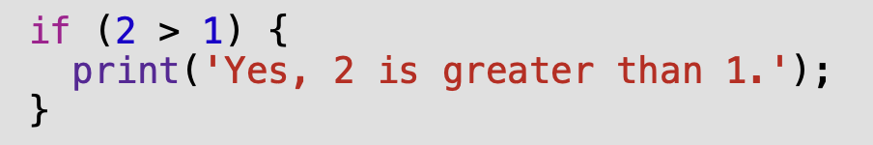
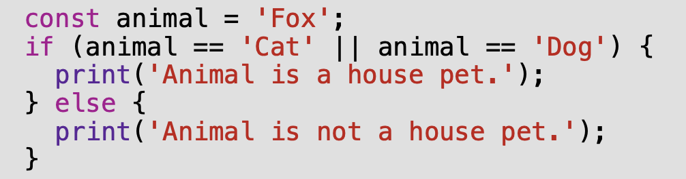
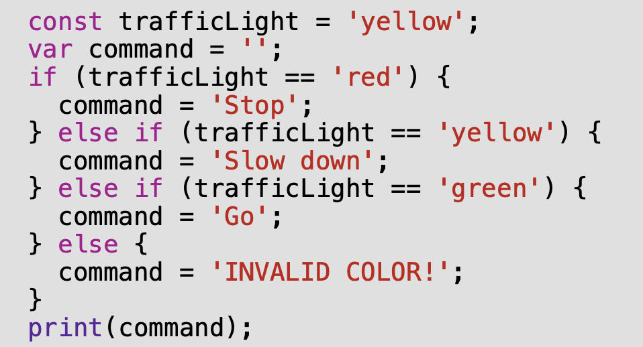
The If Statement
if statement allows the program to do something only if a certain condition is true.
The Else Clause
You can extend an if statement to provide code to run in the event that the condition turns out to be false. This is known as an else clause.
Else-If Chains

Slide 17
The If Statement
The Ternary Conditional Operator
The ternary conditional operator takes a condition and returns one of two values, depending on whether the condition is true or false. The syntax is as follows:

Slide 18
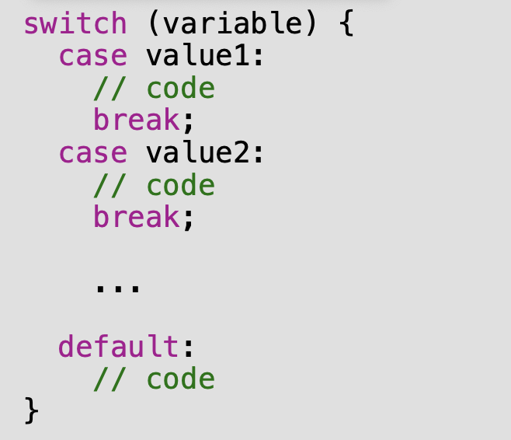
Switch Statements
An alternate way to handle control flow, especially for multiple conditions, is with a switch statement. The switch statement takes the following form:

Slide 19
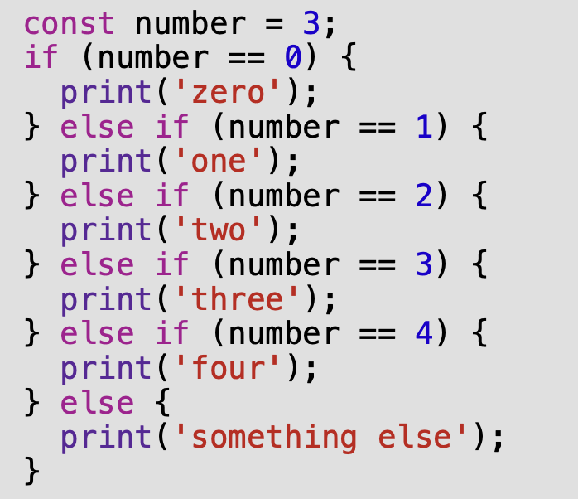
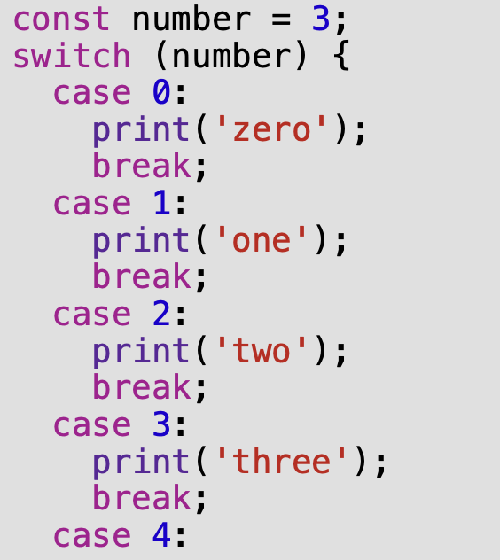
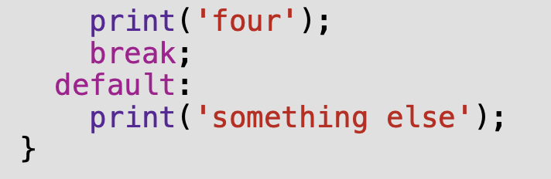
Switch Statements
Exercise: Solution
Rewrite the code above using a switch statement:

